Slide 1

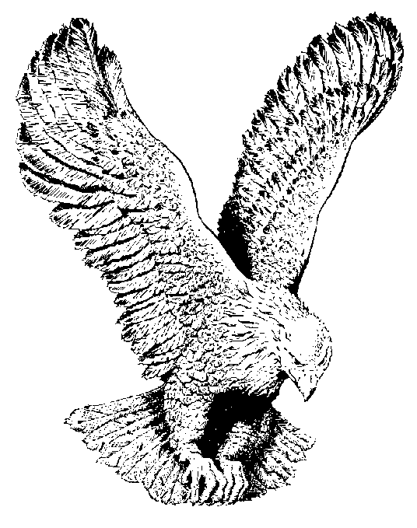
561 I AM REDEEMED
I am redeemed, by the blood of the Lamb,
I am redeemed and I know I am.
I am redeemed, by the blood of the Lamb,
Saved from sin, and I know I am.
All my sins are taken away,
Praise the Lord.

